Slide 1
Chapter 6: CPU Scheduling
Presented by
Mostafijur Rahman Akhond
Lecturer, CSE
Brac University

Slide 2
Outline
Basic Concepts
Scheduling Criteria
Scheduling Algorithms
FCFS
SJF
SRJF
RR
Priority

Slide 3
Objectives
To introduce CPU scheduling, which is the basis for multi-programmed operating systems
To describe various CPU-scheduling algorithms
To discuss evaluation criteria for selecting a CPU-scheduling algorithm for a particular system
To examine the scheduling algorithms

Slide 4
Basic Concepts
Maximum CPU utilization obtained with multiprogramming
CPU–I/O Burst Cycle – Process execution consists of a cycle of CPU execution and I/O wait
CPU burst followed by I/O burst
CPU burst distribution is of main concern

Slide 5
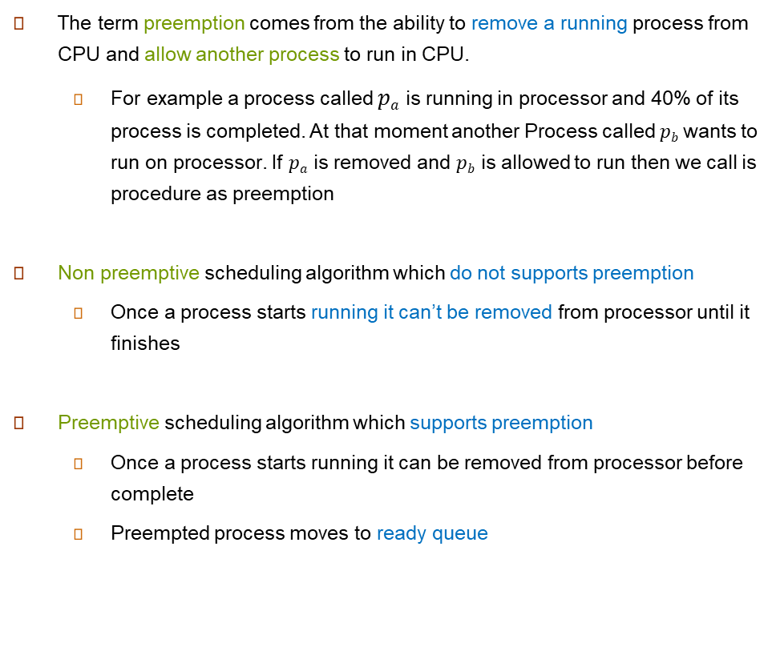





Preemptive & Non preemptive Scheduling
CPU
Figure: Non Preemptive
CPU
Figure: Preemptive

Slide 6
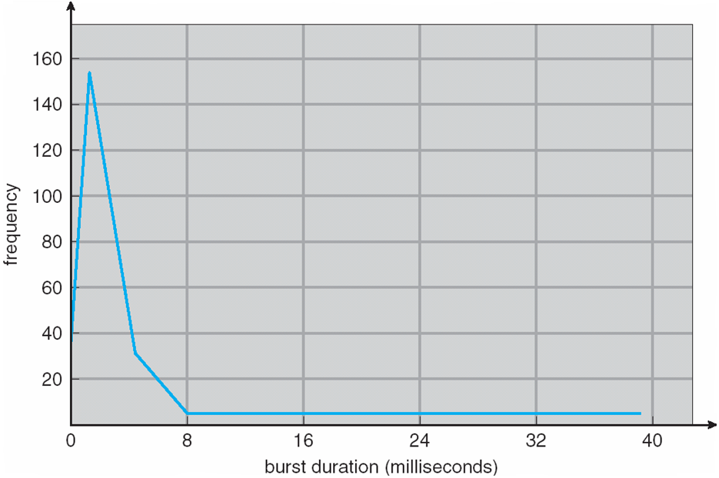
Histogram of CPU-burst Times

Slide 7
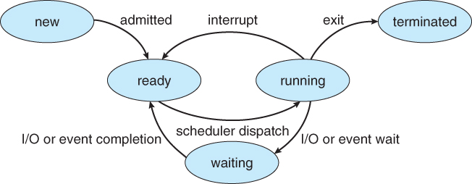
CPU Scheduler
Short-term scheduler selects from among the processes in ready queue, and allocates the CPU to one of them
Queue may be ordered in various ways
CPU scheduling decisions may take place when a process:
1. Switches from running to waiting state
2. Switches from running to ready state
3. Switches from waiting to ready
Terminates
Scheduling under 1 and 4 is non preemptive
All other scheduling is preemptive
Consider access to shared data
Consider preemption while in kernel mode
Consider interrupts occurring during crucial OS activities

Slide 8
Dispatcher
Dispatcher module gives control of the CPU to the process selected by the short-term scheduler; this involves:
switching context
switching to user mode
jumping to the proper location in the user program to restart that program
Dispatch latency – time it takes for the dispatcher to stop one process and start another running

Slide 9
Scheduling Criteria
CPU utilization – keep the CPU as busy as possible
Throughput – # of processes that complete their execution per time unit
Turnaround time – amount of time to execute a particular process
Waiting time – amount of time a process has been waiting in the ready queue
Response time – amount of time it takes from when a request was submitted until the first response is produced, not output (for time-sharing environment)

Slide 10
Scheduling Algorithm Optimization Criteria
Max CPU utilization
Max throughput
Min turnaround time
Min waiting time
Min response time

Slide 11
First- Come, First-Served (FCFS) Scheduling
Process Burst Time
P₁ 24
P₂ 3
P₃ 3
Suppose that the processes arrive in the order: P₁ , P₂ , P₃

Slide 12
FCFS: Explained
Process name | Arrival time | Burst time | Start time | Finish time | Response time (Start-arrival) | Turnaround time (Finish-arrival) | Waiting time (Finish-burst-arrival)
P1 | 0 | 24
P2 | 0 | 3
P3 | 0 | 3
0
24
0
24
0
P3
P3
P2
P1
P3
P2
24
27
24
27
24
27
30
27
30
27
Ready queue
CPU
CPU Clock
28
1
29
2
23
25
30
0
24
27
26
P1
P2
P3

Slide 13
First- Come, First-Served (FCFS) Scheduling
Process Burst Time
P₁ 24
P₂ 3
P₃ 3
Suppose that the processes arrive in the order: P₁ , P₂ , P₃ The Gantt Chart for the schedule is:
Waiting time for P₁ = 0; P₂ = 24; P₃ = 27
Average waiting time: (0 + 24 + 27)/3 = 17

Slide 14
FCFS Scheduling (Cont.)
Suppose that the processes arrive in the order:
P₂ , P₃ , P₁
The Gantt chart for the schedule is:
Waiting time for P₁ = 6; P₂ = 0; P₃ = 3
Average waiting time: (6 + 0 + 3)/3 = 3
Much better than previous case
Convoy effect - short process behind long process
Consider one CPU-bound and many I/O-bound processes

Slide 15
Shortest-Job-First (SJF) Scheduling
Associate with each process the length of its next CPU burst
Use these lengths to schedule the process with the shortest time
SJF is optimal – gives minimum average waiting time for a given set of processes
The difficulty is knowing the length of the next CPU request
Could ask the user

Slide 16
Example of SJF
ProcessArriva l Time Burst Time
P₁ 0.0 6
P₂ 2.0 8
P₃ 4.0 7
P₄ 5.0 3
SJF scheduling chart
Average waiting time = (3 + 16 + 9 + 0) / 4 = 7

Slide 17

Determining Length of Next CPU Burst
Can only estimate the length – should be similar to the previous one
Then pick process with shortest predicted next CPU burst
Can be done by using the length of previous CPU bursts, using exponential averaging
Commonly, α set to ½
Preemptive version called shortest-remaining-time-first
$$τ_{n+1}=α t_{n}+\left(1−α\right)τ_{n}.$$

Slide 18
Prediction of the Length of the Next CPU Burst

Slide 19
Examples of Exponential Averaging
α =0
τ_{n+1} = τ_{n}
Recent history does not count
α =1
τ_{n+1} = α t_{n}
Only the actual last CPU burst counts
If we expand the formula, we get:
τ_{n+1} = α t_{n}+(1 - α)α t_{n} ₋₁ + …
+(1 - α )^{j} α t_{n} _{-j} + …
+(1 - α )^{n +1} τ₀
Since both α and (1 - α) are less than or equal to 1, each successive term has less weight than its predecessor

Slide 20
Example of Shortest-remaining-time-first
Now we add the concepts of varying arrival times and preemption to the analysis
ProcessA arri Arrival TimeT Burst Time
P₁ 0 8
P₂ 1 4
P₃ 2 9
P₄ 3 5

Slide 21
SRTF: Explained
Process name | Arrival time | Burst time | Remaining Burst time | Start time | Finish time | Response time (Start-arrival) | Turnaround time (Finish-arrival) | Waiting time (Finish-burst-arrival)
P1 | 0 | 8 | 8
P2 | 1 | 4
P3 | 2 | 9
P4 | 3 | 5
P1
Ready queue
CPU
CPU Clock
0

Slide 22
SRTF: Explained
Process name | Arrival time | Burst time | Remaining Burst time | Start time | Finish time | Response time (Start-arrival) | Turnaround time (Finish-arrival) | Waiting time (Finish-burst-arrival)
P1 | 0 | 8 | 8 | 0
P2 | 1 | 4
P3 | 2 | 9
P4 | 3 | 5
Ready queue
CPU
CPU Clock
0
P1

Slide 23
SRTF: Explained
Process name | Arrival time | Burst time | Remaining Burst time | Start time | Finish time | Response time (Start-arrival) | Turnaround time (Finish-arrival) | Waiting time (Finish-burst-arrival)
P1 | 0 | 8 | 7 | 0
P2 | 1 | 4 | 4
P3 | 2 | 9
P4 | 3 | 5
P2
Ready queue
CPU
CPU Clock
1
P1

Slide 24
SRTF: Explained
Process name | Arrival time | Burst time | Remaining Burst time | Start time | Finish time | Response time (Start-arrival) | Turnaround time (Finish-arrival) | Waiting time (Finish-burst-arrival)
P1 | 0 | 8 | 7 | 0
P2 | 1 | 4 | 4 | 1
P3 | 2 | 9
P4 | 3 | 5
P1
Ready queue
CPU
CPU Clock
1
P2

Slide 25
SRTF: Explained
Process name | Arrival time | Burst time | Remaining Burst time | Start time | Finish time | Response time (Start-arrival) | Turnaround time (Finish-arrival) | Waiting time (Finish-burst-arrival)
P1 | 0 | 8 | 7 | 0
P2 | 1 | 4 | 3 | 1
P3 | 2 | 9 | 9
P4 | 3 | 5
P3
P1
Ready queue
CPU
CPU Clock
2
P2

Slide 26
SRTF: Explained
Process name | Arrival time | Burst time | Remaining Burst time | Start time | Finish time | Response time (Start-arrival) | Turnaround time (Finish-arrival) | Waiting time (Finish-burst-arrival)
P1 | 0 | 8 | 7 | 0
P2 | 1 | 4 | 2 | 1
P3 | 2 | 9 | 9
P4 | 3 | 5 | 5
P4
P3
P1
Ready queue
CPU
CPU Clock
3
P2

Slide 27
SRTF: Explained
Process name | Arrival time | Burst time | Remaining Burst time | Start time | Finish time | Response time (Start-arrival) | Turnaround time (Finish-arrival) | Waiting time (Finish-burst-arrival)
P1 | 0 | 8 | 7 | 0
P2 | 1 | 4 | 1 | 1
P3 | 2 | 9 | 9
P4 | 3 | 5 | 5
P4
P3
P1
Ready queue
CPU
CPU Clock
4
P2

Slide 28
SRTF: Explained
Process name | Arrival time | Burst time | Remaining Burst time | Start time | Finish time | Response time (Start-arrival) | Turnaround time (Finish-arrival) | Waiting time (Finish-burst-arrival)
P1 | 0 | 8 | 7 | 0
P2 | 1 | 4 | 0 | 1 | 5 | 0 | 5 | 0
P3 | 2 | 9 | 9
P4 | 3 | 5 | 5
P4
P3
P1
Ready queue
CPU
CPU Clock
5
P2

Slide 29
SRTF: Explained
Process name | Arrival time | Burst time | Remaining Burst time | Start time | Finish time | Response time (Start-arrival) | Turnaround time (Finish-arrival) | Waiting time (Finish-burst-arrival)
P1 | 0 | 8 | 7 | 0
P2 | 1 | 4 | 0 | 1 | 5 | 0 | 5 | 0
P3 | 2 | 9 | 9
P4 | 3 | 5 | 5 | 5
P3
P1
Ready queue
CPU
CPU Clock
5
P4

Slide 30
SRTF: Explained
Process name | Arrival time | Burst time | Remaining Burst time | Start time | Finish time | Response time (Start-arrival) | Turnaround time (Finish-arrival) | Waiting time (Finish-burst-arrival)
P1 | 0 | 8 | 7 | 0
P2 | 1 | 4 | 0 | 1 | 5 | 0 | 5 | 0
P3 | 2 | 9 | 9
P4 | 3 | 5 | 4 | 5
P3
P1
Ready queue
CPU
CPU Clock
6
P4

Slide 31
SRTF: Explained
Process name | Arrival time | Burst time | Remaining Burst time | Start time | Finish time | Response time (Start-arrival) | Turnaround time (Finish-arrival) | Waiting time (Finish-burst-arrival)
P1 | 0 | 8 | 7 | 0
P2 | 1 | 4 | 0 | 1 | 5 | 0 | 5 | 0
P3 | 2 | 9 | 9
P4 | 3 | 5 | 3 | 5
P3
P1
Ready queue
CPU
CPU Clock
7
P4

Slide 32
SRTF: Explained
Process name | Arrival time | Burst time | Remaining Burst time | Start time | Finish time | Response time (Start-arrival) | Turnaround time (Finish-arrival) | Waiting time (Finish-burst-arrival)
P1 | 0 | 8 | 7 | 0
P2 | 1 | 4 | 0 | 1 | 5 | 0 | 5 | 0
P3 | 2 | 9 | 9
P4 | 3 | 5 | 2 | 5
P3
P1
Ready queue
CPU
CPU Clock
8
P4

Slide 33
SRTF: Explained
Process name | Arrival time | Burst time | Remaining Burst time | Start time | Finish time | Response time (Start-arrival) | Turnaround time (Finish-arrival) | Waiting time (Finish-burst-arrival)
P1 | 0 | 8 | 7 | 0
P2 | 1 | 4 | 0 | 1 | 5 | 0 | 5 | 0
P3 | 2 | 9 | 9
P4 | 3 | 5 | 1 | 5
P3
P1
Ready queue
CPU
CPU Clock
9
P4

Slide 34
SRTF: Explained
Process name | Arrival time | Burst time | Remaining Burst time | Start time | Finish time | Response time (Start-arrival) | Turnaround time (Finish-arrival) | Waiting time (Finish-burst-arrival)
P1 | 0 | 8 | 7 | 0
P2 | 1 | 4 | 0 | 1 | 5 | 0 | 5 | 0
P3 | 2 | 9 | 9
P4 | 3 | 5 | 0 | 5 | 10 | 2 | 7 | 2
P3
P1
Ready queue
CPU
CPU Clock
10
P4

Slide 35
SRTF: Explained
Process name | Arrival time | Burst time | Remaining Burst time | Start time | Finish time | Response time (Start-arrival) | Turnaround time (Finish-arrival) | Waiting time (Finish-burst-arrival)
P1 | 0 | 8 | 7 | 0
P2 | 1 | 4 | 0 | 1 | 5 | 0 | 5 | 0
P3 | 2 | 9 | 9
P4 | 3 | 5 | 0 | 5 | 10 | 2 | 7 | 2
P3
Ready queue
CPU
CPU Clock
10
P1

Slide 36
SRTF: Explained
Process name | Arrival time | Burst time | Remaining Burst time | Start time | Finish time | Response time (Start-arrival) | Turnaround time (Finish-arrival) | Waiting time (Finish-burst-arrival)
P1 | 0 | 8 | 6 | 0
P2 | 1 | 4 | 0 | 1 | 5 | 0 | 5 | 0
P3 | 2 | 9 | 9
P4 | 3 | 5 | 0 | 5 | 10 | 2 | 7 | 2
P3
Ready queue
CPU
CPU Clock
11
P1

Slide 37
SRTF: Explained
Process name | Arrival time | Burst time | Remaining Burst time | Start time | Finish time | Response time (Start-arrival) | Turnaround time (Finish-arrival) | Waiting time (Finish-burst-arrival)
P1 | 0 | 8 | 5 | 0
P2 | 1 | 4 | 0 | 1 | 5 | 0 | 5 | 0
P3 | 2 | 9 | 9
P4 | 3 | 5 | 0 | 5 | 10 | 2 | 7 | 2
P3
Ready queue
CPU
CPU Clock
12
P1

Slide 38
SRTF: Explained
Process name | Arrival time | Burst time | Remaining Burst time | Start time | Finish time | Response time (Start-arrival) | Turnaround time (Finish-arrival) | Waiting time (Finish-burst-arrival)
P1 | 0 | 8 | 4 | 0
P2 | 1 | 4 | 0 | 1 | 5 | 0 | 5 | 0
P3 | 2 | 9 | 9
P4 | 3 | 5 | 0 | 5 | 10 | 2 | 7 | 2
P3
Ready queue
CPU
CPU Clock
13
P1

Slide 39
SRTF: Explained
Process name | Arrival time | Burst time | Remaining Burst time | Start time | Finish time | Response time (Start-arrival) | Turnaround time (Finish-arrival) | Waiting time (Finish-burst-arrival)
P1 | 0 | 8 | 3 | 0
P2 | 1 | 4 | 0 | 1 | 5 | 0 | 5 | 0
P3 | 2 | 9 | 9
P4 | 3 | 5 | 0 | 5 | 10 | 2 | 7 | 2
P3
Ready queue
CPU
CPU Clock
14
P1

Slide 40
SRTF: Explained
Process name | Arrival time | Burst time | Remaining Burst time | Start time | Finish time | Response time (Start-arrival) | Turnaround time (Finish-arrival) | Waiting time (Finish-burst-arrival)
P1 | 0 | 8 | 2 | 0
P2 | 1 | 4 | 0 | 1 | 5 | 0 | 5 | 0
P3 | 2 | 9 | 9
P4 | 3 | 5 | 0 | 5 | 10 | 2 | 7 | 2
P3
Ready queue
CPU
CPU Clock
15
P1

Slide 41
SRTF: Explained
Process name | Arrival time | Burst time | Remaining Burst time | Start time | Finish time | Response time (Start-arrival) | Turnaround time (Finish-arrival) | Waiting time (Finish-burst-arrival)
P1 | 0 | 8 | 1 | 0
P2 | 1 | 4 | 0 | 1 | 5 | 0 | 5 | 0
P3 | 2 | 9 | 9
P4 | 3 | 5 | 0 | 5 | 10 | 2 | 7 | 2
P3
Ready queue
CPU
CPU Clock
16
P1

Slide 42
SRTF: Explained
Process name | Arrival time | Burst time | Remaining Burst time | Start time | Finish time | Response time (Start-arrival) | Turnaround time (Finish-arrival) | Waiting time (Finish-burst-arrival)
P1 | 0 | 8 | 0 | 0 | 17 | 0 | 17 | 9
P2 | 1 | 4 | 0 | 1 | 5 | 0 | 5 | 0
P3 | 2 | 9 | 9
P4 | 3 | 5 | 0 | 5 | 10 | 2 | 7 | 2
P3
Ready queue
CPU
CPU Clock
17
P1

Slide 43
SRTF: Explained
Process name | Arrival time | Burst time | Remaining Burst time | Start time | Finish time | Response time (Start-arrival) | Turnaround time (Finish-arrival) | Waiting time (Finish-burst-arrival)
P1 | 0 | 8 | 0 | 0 | 17 | 0 | 17 | 9
P2 | 1 | 4 | 0 | 1 | 5 | 0 | 5 | 0
P3 | 2 | 9 | 9 | 17
P4 | 3 | 5 | 0 | 5 | 10 | 2 | 7 | 2
Ready queue
CPU
CPU Clock
17
P3

Slide 44
SRTF: Explained
Process name | Arrival time | Burst time | Remaining Burst time | Start time | Finish time | Response time (Start-arrival) | Turnaround time (Finish-arrival) | Waiting time (Finish-burst-arrival)
P1 | 0 | 8 | 0 | 0 | 17 | 0 | 17 | 9
P2 | 1 | 4 | 0 | 1 | 5 | 0 | 5 | 0
P3 | 2 | 9 | 8 | 17
P4 | 3 | 5 | 0 | 5 | 10 | 2 | 7 | 2
Ready queue
CPU
CPU Clock
18
P3

Slide 45
SRTF: Explained
Process name | Arrival time | Burst time | Remaining Burst time | Start time | Finish time | Response time (Start-arrival) | Turnaround time (Finish-arrival) | Waiting time (Finish-burst-arrival)
P1 | 0 | 8 | 0 | 0 | 17 | 0 | 17 | 9
P2 | 1 | 4 | 0 | 1 | 5 | 0 | 5 | 0
P3 | 2 | 9 | 0 | 17 | 26 | 15 | 24 | 15
P4 | 3 | 5 | 0 | 5 | 10 | 2 | 7 | 2
Ready queue
CPU
CPU Clock
26
P3

Slide 46
Example of Shortest-remaining-time-first
Now we add the concepts of varying arrival times and preemption to the analysis
Preemptive SJF Gantt Chart
Average waiting time = [(10-1)+(1-1)+(17-2)+5-3)]/4 = 26/4 = 6.5 msec
Process name | Arrival time | Burst time | Remaining Burst time | Start time | Finish time | Response time (Start-arrival) | Turnaround time (Finish-arrival) | Waiting time (Finish-burst-arrival)
P1 | 0 | 8 | 0 | 0 | 17 | 0 | 17 | 9
P2 | 1 | 4 | 0 | 1 | 5 | 0 | 5 | 0
P3 | 2 | 9 | 0 | 17 | 26 | 15 | 24 | 15
P4 | 3 | 5 | 0 | 5 | 10 | 2 | 7 | 2

Slide 47
Priority Scheduling
A priority number (integer) is associated with each process
The CPU is allocated to the process with the highest priority (smallest integer ≡ highest priority)
Preemptive
Nonpreemptive
SJF is priority scheduling where priority is the inverse of predicted next CPU burst time
Problem ≡ Starvation – low priority processes may never execute
Solution ≡ Aging – as time progresses increase the priority of the process

Slide 48
Example of Priority Scheduling
ProcessA arri Burst TimeT Priority
P₁ 10 3
P₂ 1 1
P₃ 2 4
P₄ 1 5
P₅ 6 2

Slide 49
Priority: Explained
Process name | Arrival time | Burst time | Priority | Start time | Finish time | Response time (Start-arrival) | Turnaround time (Finish-arrival) | Waiting time (Finish-burst-arrival)
P1 | 0 | 10 | 3
P2 | 0 | 1 | 1
P3 | 0 | 2 | 4
P4 | 0 | 1 | 5
P5 | 0 | 6 | 2
P5
P4
P3
P2
P1
Ready queue
CPU
CPU Clock
0

Slide 50
Priority: Explained
Process name | Arrival time | Burst time | Priority | Start time | Finish time | Response time (Start-arrival) | Turnaround time (Finish-arrival) | Waiting time (Finish-burst-arrival)
P1 | 0 | 10 | 3
P2 | 0 | 1 | 1 | 0
P3 | 0 | 2 | 4
P4 | 0 | 1 | 5
P5 | 0 | 6 | 2
P5
P4
P3
P1
Ready queue
CPU
CPU Clock
0
P2

Slide 51
Priority: Explained
Process name | Arrival time | Burst time | Priority | Start time | Finish time | Response time (Start-arrival) | Turnaround time (Finish-arrival) | Waiting time (Finish-burst-arrival)
P1 | 0 | 10 | 3
P2 | 0 | 1 | 1 | 0 | 1 | 0 | 1 | 0
P3 | 0 | 2 | 4
P4 | 0 | 1 | 5
P5 | 0 | 6 | 2
P5
P4
P3
P1
Ready queue
CPU
CPU Clock
1
P2

Slide 52
Priority: Explained
Process name | Arrival time | Burst time | Priority | Start time | Finish time | Response time (Start-arrival) | Turnaround time (Finish-arrival) | Waiting time (Finish-burst-arrival)
P1 | 0 | 10 | 3
P2 | 0 | 1 | 1 | 0 | 1 | 0 | 1 | 0
P3 | 0 | 2 | 4
P4 | 0 | 1 | 5
P5 | 0 | 6 | 2 | 1
P4
P3
P1
Ready queue
CPU
CPU Clock
1
P5

Slide 53
Priority: Explained
Process name | Arrival time | Burst time | Priority | Start time | Finish time | Response time (Start-arrival) | Turnaround time (Finish-arrival) | Waiting time (Finish-burst-arrival)
P1 | 0 | 10 | 3
P2 | 0 | 1 | 1 | 0 | 1 | 0 | 1 | 0
P3 | 0 | 2 | 4
P4 | 0 | 1 | 5
P5 | 0 | 5 | 2 | 1
P4
P3
P1
Ready queue
CPU
CPU Clock
2
P5

Slide 54
Priority: Explained
Process name | Arrival time | Burst time | Priority | Start time | Finish time | Response time (Start-arrival) | Turnaround time (Finish-arrival) | Waiting time (Finish-burst-arrival)
P1 | 0 | 10 | 3
P2 | 0 | 1 | 1 | 0 | 1 | 0 | 1 | 0
P3 | 0 | 2 | 4
P4 | 0 | 1 | 5
P5 | 0 | 6 | 2 | 1
P4
P3
P1
Ready queue
CPU
CPU Clock
3..6
P5

Slide 55
Priority: Explained
Process name | Arrival time | Burst time | Priority | Start time | Finish time | Response time (Start-arrival) | Turnaround time (Finish-arrival) | Waiting time (Finish-burst-arrival)
P1 | 0 | 10 | 3
P2 | 0 | 1 | 1 | 0 | 1 | 0 | 1 | 0
P3 | 0 | 2 | 4
P4 | 0 | 1 | 5
P5 | 0 | 5 | 2 | 1 | 7 | 1 | 7 | 1
P4
P3
P1
Ready queue
CPU
CPU Clock
7
P5

Slide 56
Priority: Explained
Process name | Arrival time | Burst time | Priority | Start time | Finish time | Response time (Start-arrival) | Turnaround time (Finish-arrival) | Waiting time (Finish-burst-arrival)
P1 | 0 | 10 | 3 | 7
P2 | 0 | 1 | 1 | 0 | 1 | 0 | 1 | 0
P3 | 0 | 2 | 4
P4 | 0 | 1 | 5
P5 | 0 | 6 | 2 | 1 | 7 | 1 | 7 | 1
P4
P3
Ready queue
CPU
CPU Clock
7
P1

Slide 57
Priority: Explained
Process name | Arrival time | Burst time | Priority | Start time | Finish time | Response time (Start-arrival) | Turnaround time (Finish-arrival) | Waiting time (Finish-burst-arrival)
P1 | 0 | 10 | 3 | 7
P2 | 0 | 1 | 1 | 0 | 1 | 0 | 1 | 0
P3 | 0 | 2 | 4
P4 | 0 | 1 | 5
P5 | 0 | 6 | 2 | 1 | 7 | 1 | 7 | 1
P4
P3
Ready queue
CPU
CPU Clock
8…16
P1

Slide 58
Priority: Explained
Process name | Arrival time | Burst time | Priority | Start time | Finish time | Response time (Start-arrival) | Turnaround time (Finish-arrival) | Waiting time (Finish-burst-arrival)
P1 | 0 | 10 | 3 | 7 | 17 | 7 | 17 | 7
P2 | 0 | 1 | 1 | 0 | 1 | 0 | 1 | 0
P3 | 0 | 2 | 4
P4 | 0 | 1 | 5
P5 | 0 | 6 | 2 | 1 | 7 | 1 | 7 | 1
P4
P3
Ready queue
CPU
CPU Clock
17
P1

Slide 59
Priority: Explained
Process name | Arrival time | Burst time | Priority | Start time | Finish time | Response time (Start-arrival) | Turnaround time (Finish-arrival) | Waiting time (Finish-burst-arrival)
P1 | 0 | 10 | 3 | 7 | 17 | 7 | 17 | 7
P2 | 0 | 1 | 1 | 0 | 1 | 0 | 1 | 0
P3 | 0 | 2 | 4 | 17
P4 | 0 | 1 | 5
P5 | 0 | 6 | 2 | 1 | 7 | 1 | 7 | 1
P4
Ready queue
CPU
CPU Clock
17
P3

Slide 60
Priority: Explained
Process name | Arrival time | Burst time | Priority | Start time | Finish time | Response time (Start-arrival) | Turnaround time (Finish-arrival) | Waiting time (Finish-burst-arrival)
P1 | 0 | 10 | 3 | 7 | 17 | 7 | 17 | 7
P2 | 0 | 1 | 1 | 0 | 1 | 0 | 1 | 0
P3 | 0 | 2 | 4 | 17
P4 | 0 | 1 | 5
P5 | 0 | 6 | 2 | 1 | 7 | 1 | 7 | 1
P4
Ready queue
CPU
CPU Clock
18
P3

Slide 61
Priority: Explained
Process name | Arrival time | Burst time | Priority | Start time | Finish time | Response time (Start-arrival) | Turnaround time (Finish-arrival) | Waiting time (Finish-burst-arrival)
P1 | 0 | 10 | 3 | 7 | 17 | 7 | 17 | 7
P2 | 0 | 1 | 1 | 0 | 1 | 0 | 1 | 0
P3 | 0 | 2 | 4 | 17 | 19 | 17 | 19 | 17
P4 | 0 | 1 | 5
P5 | 0 | 6 | 2 | 1 | 7 | 1 | 7 | 1
P4
Ready queue
CPU
CPU Clock
19
P3

Slide 62
Priority: Explained
Process name | Arrival time | Burst time | Priority | Start time | Finish time | Response time (Start-arrival) | Turnaround time (Finish-arrival) | Waiting time (Finish-burst-arrival)
P1 | 0 | 10 | 3 | 7 | 17 | 7 | 17 | 7
P2 | 0 | 1 | 1 | 0 | 1 | 0 | 1 | 0
P3 | 0 | 2 | 4 | 17 | 19 | 17 | 19 | 17
P4 | 0 | 1 | 5 | 19
P5 | 0 | 6 | 2 | 1 | 7 | 1 | 7 | 1
Ready queue
CPU
CPU Clock
19
P4

Slide 63
Priority: Explained
Process name | Arrival time | Burst time | Priority | Start time | Finish time | Response time (Start-arrival) | Turnaround time (Finish-arrival) | Waiting time (Finish-burst-arrival)
P1 | 0 | 10 | 3 | 7 | 17 | 7 | 17 | 7
P2 | 0 | 1 | 1 | 0 | 1 | 0 | 1 | 0
P3 | 0 | 2 | 4 | 17 | 19 | 17 | 19 | 17
P4 | 0 | 1 | 5 | 19 | 20 | 19 | 20 | 19
P5 | 0 | 6 | 2 | 1 | 7 | 1 | 7 | 1
Ready queue
CPU
CPU Clock
20
P4

Slide 64
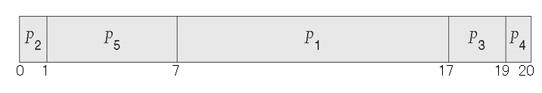
Example of Priority Scheduling
Analyzing the priority scheduling –
Priority scheduling Gantt Chart
Average waiting time = 8.2 msec
Process name | Arrival time | Burst time | Priority | Start time | Finish time | Response time (Start-arrival) | Turnaround time (Finish-arrival) | Waiting time (Finish-burst-arrival)
P1 | 0 | 10 | 3 | 7 | 17 | 7 | 17 | 7
P2 | 0 | 1 | 1 | 0 | 1 | 0 | 1 | 0
P3 | 0 | 2 | 4 | 17 | 19 | 17 | 19 | 17
P4 | 0 | 1 | 5 | 19 | 20 | 19 | 20 | 19
P5 | 0 | 6 | 2 | 1 | 7 | 1 | 7 | 1

Slide 65
Round Robin (RR)
Each process gets a small unit of CPU time (time quantum q), usually 10-100 milliseconds. After this time has elapsed, the process is preempted and added to the end of the ready queue.
If there are n processes in the ready queue and the time quantum is q, then each process gets 1/n of the CPU time in chunks of at most q time units at once. No process waits more than (n-1)q time units.
Timer interrupts every quantum to schedule next process
Performance
q large ⇒ FIFO
q small ⇒ q must be large with respect to context switch, otherwise overhead is too high

Slide 66
Example of RR
Process Burst Time
P₁ 24
P₂ 3
P₃ 3
Consider the time quantum is 4

Slide 67
Round Robin: Explained
Process name | Arrival time | Burst time | Remaining Burst time | Start time | Finish time | Response time (Start-arrival) | Turnaround time (Finish-arrival) | Waiting time (Finish-burst-arrival)
P1 | 0 | 24 | 24
P2 | 0 | 3 | 3
P3 | 0 | 3 | 3
P3
P2
P1
Time quantum = 4
Ready queue
CPU
CPU Clock
0
Gantt Chart

Slide 68
Round Robin: Explained
Process name | Arrival time | Burst time | Remaining Burst time | Start time | Finish time | Response time (Start-arrival) | Turnaround time (Finish-arrival) | Waiting time (Finish-burst-arrival)
P1 | 0 | 24 | 24 | 0
P2 | 0 | 3 | 3
P3 | 0 | 3 | 3
P3
P2
Time quantum = 4
Elapsed (0)
Ready queue
CPU
CPU Clock
0
P1
Gantt Chart

Slide 69
Round Robin: Explained
Process name | Arrival time | Burst time | Remaining Burst time | Start time | Finish time | Response time (Start-arrival) | Turnaround time (Finish-arrival) | Waiting time (Finish-burst-arrival)
P1 | 0 | 24 | 23 | 0
P2 | 0 | 3 | 3
P3 | 0 | 3 | 3
P3
P2
Time quantum = 4
Elapsed (1)
Ready queue
CPU
CPU Clock
1
P1
Gantt Chart

Slide 70
Round Robin: Explained
Process name | Arrival time | Burst time | Remaining Burst time | Start time | Finish time | Response time (Start-arrival) | Turnaround time (Finish-arrival) | Waiting time (Finish-burst-arrival)
P1 | 0 | 24 | 22 | 0
P2 | 0 | 3 | 3
P3 | 0 | 3 | 3
P3
P2
Time quantum = 4
Elapsed (2)
Ready queue
CPU
CPU Clock
2
P1
Gantt Chart

Slide 71
Round Robin: Explained
Process name | Arrival time | Burst time | Remaining Burst time | Start time | Finish time | Response time (Start-arrival) | Turnaround time (Finish-arrival) | Waiting time (Finish-burst-arrival)
P1 | 0 | 24 | 21 | 0
P2 | 0 | 3 | 3
P3 | 0 | 3 | 3
P3
P2
Time quantum = 4
Elapsed (3)
Ready queue
CPU
CPU Clock
3
P1
Gantt Chart

Slide 72
Round Robin: Explained
Process name | Arrival time | Burst time | Remaining Burst time | Start time | Finish time | Response time (Start-arrival) | Turnaround time (Finish-arrival) | Waiting time (Finish-burst-arrival)
P1 | 0 | 24 | 20 | 0
P2 | 0 | 3 | 3
P3 | 0 | 3 | 3
P3
P2
Time quantum = 4
Elapsed (4)
Ready queue
CPU
CPU Clock
4
P1
Gantt Chart

Slide 73
Round Robin: Explained
Process name | Arrival time | Burst time | Remaining Burst time | Start time | Finish time | Response time (Start-arrival) | Turnaround time (Finish-arrival) | Waiting time (Finish-burst-arrival)
P1 | 0 | 24 | 20 | 0
P2 | 0 | 3 | 3 | 4
P3 | 0 | 3 | 3
P1
P3
Time quantum = 4
Elapsed (0)
Ready queue
CPU
CPU Clock
4
P2
Gantt Chart

Slide 74
Round Robin: Explained
Process name | Arrival time | Burst time | Remaining Burst time | Start time | Finish time | Response time (Start-arrival) | Turnaround time (Finish-arrival) | Waiting time (Finish-burst-arrival)
P1 | 0 | 24 | 20 | 0
P2 | 0 | 3 | 2 | 4
P3 | 0 | 3 | 3
P1
P3
Time quantum = 4
Elapsed (1)
Ready queue
CPU
CPU Clock
5
P2
Gantt Chart

Slide 75
Round Robin: Explained
Process name | Arrival time | Burst time | Remaining Burst time | Start time | Finish time | Response time (Start-arrival) | Turnaround time (Finish-arrival) | Waiting time (Finish-burst-arrival)
P1 | 0 | 24 | 20 | 0
P2 | 0 | 3 | 1 | 4
P3 | 0 | 3 | 3
P1
P3
Time quantum = 4
Elapsed (2)
Ready queue
CPU
CPU Clock
6
P2
Gantt Chart

Slide 76
Round Robin: Explained
Process name | Arrival time | Burst time | Remaining Burst time | Start time | Finish time | Response time (Start-arrival) | Turnaround time (Finish-arrival) | Waiting time (Finish-burst-arrival)
P1 | 0 | 24 | 20 | 0
P2 | 0 | 3 | 0 | 4 | 7 | 4 | 7 | 4
P3 | 0 | 3 | 3
P1
P3
Time quantum = 4
Elapsed (3)
Ready queue
CPU
CPU Clock
7
P2
Gantt Chart

Slide 77
Round Robin: Explained
Process name | Arrival time | Burst time | Remaining Burst time | Start time | Finish time | Response time (Start-arrival) | Turnaround time (Finish-arrival) | Waiting time (Finish-burst-arrival)
P1 | 0 | 24 | 20 | 0
P2 | 0 | 3 | 0 | 4 | 7 | 4 | 7 | 4
P3 | 0 | 3 | 3 | 7
P1
Time quantum = 4
Elapsed (0)
Ready queue
CPU
CPU Clock
7
P3
Gantt Chart

Slide 78
Round Robin: Explained
Process name | Arrival time | Burst time | Remaining Burst time | Start time | Finish time | Response time (Start-arrival) | Turnaround time (Finish-arrival) | Waiting time (Finish-burst-arrival)
P1 | 0 | 24 | 20 | 0
P2 | 0 | 3 | 0 | 4 | 7 | 4 | 7 | 4
P3 | 0 | 3 | 2 | 7
P1
Time quantum = 4
Elapsed (1)
Ready queue
CPU
CPU Clock
8
P3
Gantt Chart

Slide 79
Round Robin: Explained
Process name | Arrival time | Burst time | Remaining Burst time | Start time | Finish time | Response time (Start-arrival) | Turnaround time (Finish-arrival) | Waiting time (Finish-burst-arrival)
P1 | 0 | 24 | 20 | 0
P2 | 0 | 3 | 0 | 4 | 7 | 4 | 7 | 4
P3 | 0 | 3 | 1 | 7
P1
Time quantum = 4
Elapsed (2)
Ready queue
CPU
CPU Clock
9
P3
Gantt Chart

Slide 80
Round Robin: Explained
Process name | Arrival time | Burst time | Remaining Burst time | Start time | Finish time | Response time (Start-arrival) | Turnaround time (Finish-arrival) | Waiting time (Finish-burst-arrival)
P1 | 0 | 24 | 20 | 0
P2 | 0 | 3 | 0 | 4 | 7 | 4 | 7 | 4
P3 | 0 | 3 | 0 | 7 | 10 | 7 | 10 | 7
P1
Time quantum = 4
Elapsed (3)
Ready queue
CPU
CPU Clock
10
P3
Gantt Chart

Slide 81
Round Robin: Explained
Process name | Arrival time | Burst time | Remaining Burst time | Start time | Finish time | Response time (Start-arrival) | Turnaround time (Finish-arrival) | Waiting time (Finish-burst-arrival)
P1 | 0 | 24 | 20 | 0
P2 | 0 | 3 | 0 | 4 | 7 | 4 | 7 | 4
P3 | 0 | 3 | 0 | 7 | 10 | 7 | 10 | 7
Time quantum = 4
Elapsed (0)
Ready queue
CPU
CPU Clock
10
P1
Gantt Chart

Slide 82
Round Robin: Explained
Process name | Arrival time | Burst time | Remaining Burst time | Start time | Finish time | Response time (Start-arrival) | Turnaround time (Finish-arrival) | Waiting time (Finish-burst-arrival)
P1 | 0 | 24 | 19 | 0
P2 | 0 | 3 | 0 | 4 | 7 | 4 | 7 | 4
P3 | 0 | 3 | 0 | 7 | 10 | 7 | 10 | 7
Time quantum = 4
Elapsed (1)
Ready queue
CPU
CPU Clock
11
P1
Gantt Chart

Slide 83
Round Robin: Explained
Process name | Arrival time | Burst time | Remaining Burst time | Start time | Finish time | Response time (Start-arrival) | Turnaround time (Finish-arrival) | Waiting time (Finish-burst-arrival)
P1 | 0 | 24 | 18 | 0
P2 | 0 | 3 | 0 | 4 | 7 | 4 | 7 | 4
P3 | 0 | 3 | 0 | 7 | 10 | 7 | 10 | 7
Time quantum = 4
Elapsed (2)
Ready queue
CPU
CPU Clock
12
P1
Gantt Chart

Slide 84
Round Robin: Explained
Process name | Arrival time | Burst time | Remaining Burst time | Start time | Finish time | Response time (Start-arrival) | Turnaround time (Finish-arrival) | Waiting time (Finish-burst-arrival)
P1 | 0 | 24 | 17 | 0
P2 | 0 | 3 | 0 | 4 | 7 | 4 | 7 | 4
P3 | 0 | 3 | 0 | 7 | 10 | 7 | 10 | 7
Time quantum = 4
Elapsed (3)
Ready queue
CPU
CPU Clock
13
P1
Gantt Chart

Slide 85
Round Robin: Explained
Process name | Arrival time | Burst time | Remaining Burst time | Start time | Finish time | Response time (Start-arrival) | Turnaround time (Finish-arrival) | Waiting time (Finish-burst-arrival)
P1 | 0 | 24 | 16 | 0
P2 | 0 | 3 | 0 | 4 | 7 | 4 | 7 | 4
P3 | 0 | 3 | 0 | 7 | 10 | 7 | 10 | 7
Time quantum = 4
Elapsed (4)
Ready queue
CPU
CPU Clock
14
P1
Gantt Chart

Slide 86
Round Robin: Explained
Process name | Arrival time | Burst time | Remaining Burst time | Start time | Finish time | Response time (Start-arrival) | Turnaround time (Finish-arrival) | Waiting time (Finish-burst-arrival)
P1 | 0 | 24 | 16 | 0
P2 | 0 | 3 | 0 | 4 | 7 | 4 | 7 | 4
P3 | 0 | 3 | 0 | 7 | 10 | 7 | 10 | 7
P1
Time quantum = 4
Elapsed (4)
Ready queue
CPU
CPU Clock
14
Gantt Chart

Slide 87
Round Robin: Explained
Process name | Arrival time | Burst time | Remaining Burst time | Start time | Finish time | Response time (Start-arrival) | Turnaround time (Finish-arrival) | Waiting time (Finish-burst-arrival)
P1 | 0 | 24 | 16 | 0
P2 | 0 | 3 | 0 | 4 | 7 | 4 | 7 | 4
P3 | 0 | 3 | 0 | 7 | 10 | 7 | 10 | 7
Time quantum = 4
Elapsed (0)
Ready queue
CPU
CPU Clock
14
P1
Gantt Chart

Slide 88
Round Robin: Explained
Process name | Arrival time | Burst time | Remaining Burst time | Start time | Finish time | Response time (Start-arrival) | Turnaround time (Finish-arrival) | Waiting time (Finish-burst-arrival)
P1 | 0 | 24 | 15 | 0
P2 | 0 | 3 | 0 | 4 | 7 | 4 | 7 | 4
P3 | 0 | 3 | 0 | 7 | 10 | 7 | 10 | 7
Time quantum = 4
Elapsed (1)
Ready queue
CPU
CPU Clock
15
P1
Gantt Chart

Slide 89
Round Robin: Explained
Process name | Arrival time | Burst time | Remaining Burst time | Start time | Finish time | Response time (Start-arrival) | Turnaround time (Finish-arrival) | Waiting time (Finish-burst-arrival)
P1 | 0 | 24 | 14 | 0
P2 | 0 | 3 | 0 | 4 | 7 | 4 | 7 | 4
P3 | 0 | 3 | 0 | 7 | 10 | 7 | 10 | 7
Time quantum = 4
Elapsed (2)
Ready queue
CPU
CPU Clock
16
P1
Gantt Chart

Slide 90
Round Robin: Explained
Process name | Arrival time | Burst time | Remaining Burst time | Start time | Finish time | Response time (Start-arrival) | Turnaround time (Finish-arrival) | Waiting time (Finish-burst-arrival)
P1 | 0 | 24 | 13 | 0
P2 | 0 | 3 | 0 | 4 | 7 | 4 | 7 | 4
P3 | 0 | 3 | 0 | 7 | 10 | 7 | 10 | 7
Time quantum = 4
Elapsed (3)
Ready queue
CPU
CPU Clock
17
P1
Gantt Chart

Slide 91
Round Robin: Explained
Process name | Arrival time | Burst time | Remaining Burst time | Start time | Finish time | Response time (Start-arrival) | Turnaround time (Finish-arrival) | Waiting time (Finish-burst-arrival)
P1 | 0 | 24 | 12 | 0
P2 | 0 | 3 | 0 | 4 | 7 | 4 | 7 | 4
P3 | 0 | 3 | 0 | 7 | 10 | 7 | 10 | 7
Time quantum = 4
Elapsed (4)
Ready queue
CPU
CPU Clock
18
P1
Gantt Chart

Slide 92
Round Robin: Explained
Process name | Arrival time | Burst time | Remaining Burst time | Start time | Finish time | Response time (Start-arrival) | Turnaround time (Finish-arrival) | Waiting time (Finish-burst-arrival)
P1 | 0 | 24 | 12 | 0
P2 | 0 | 3 | 0 | 4 | 7 | 4 | 7 | 4
P3 | 0 | 3 | 0 | 7 | 10 | 7 | 10 | 7
P1
Time quantum = 4
Elapsed (4)
Ready queue
CPU
CPU Clock
18
Gantt Chart

Slide 93
Round Robin: Explained
Process name | Arrival time | Burst time | Remaining Burst time | Start time | Finish time | Response time (Start-arrival) | Turnaround time (Finish-arrival) | Waiting time (Finish-burst-arrival)
P1 | 0 | 24 | 12 | 0
P2 | 0 | 3 | 0 | 4 | 7 | 4 | 7 | 4
P3 | 0 | 3 | 0 | 7 | 10 | 7 | 10 | 7
Time quantum = 4
Elapsed (0)
Ready queue
CPU
CPU Clock
18
P1
Gantt Chart

Slide 94
Round Robin: Explained
Process name | Arrival time | Burst time | Remaining Burst time | Start time | Finish time | Response time (Start-arrival) | Turnaround time (Finish-arrival) | Waiting time (Finish-burst-arrival)
P1 | 0 | 24 | 11..8 | 0
P2 | 0 | 3 | 0 | 4 | 7 | 4 | 7 | 4
P3 | 0 | 3 | 0 | 7 | 10 | 7 | 10 | 7
Time quantum = 4
Elapsed (1..4)
Ready queue
CPU
CPU Clock
19..22
P1
Gantt Chart

Slide 95
Round Robin: Explained
Process name | Arrival time | Burst time | Remaining Burst time | Start time | Finish time | Response time (Start-arrival) | Turnaround time (Finish-arrival) | Waiting time (Finish-burst-arrival)
P1 | 0 | 24 | 8 | 0
P2 | 0 | 3 | 0 | 4 | 7 | 4 | 7 | 4
P3 | 0 | 3 | 0 | 7 | 10 | 7 | 10 | 7
P1
Time quantum = 4
Elapsed (4)
Ready queue
CPU
CPU Clock
22
Gantt Chart

Slide 96
Round Robin: Explained
Process name | Arrival time | Burst time | Remaining Burst time | Start time | Finish time | Response time (Start-arrival) | Turnaround time (Finish-arrival) | Waiting time (Finish-burst-arrival)
P1 | 0 | 24 | 8..4 | 0
P2 | 0 | 3 | 0 | 4 | 7 | 4 | 7 | 4
P3 | 0 | 3 | 0 | 7 | 10 | 7 | 10 | 7
Time quantum = 4
Elapsed (0..4)
Ready queue
CPU
CPU Clock
22..26
P1
Gantt Chart

Slide 97
Round Robin: Explained
Process name | Arrival time | Burst time | Remaining Burst time | Start time | Finish time | Response time (Start-arrival) | Turnaround time (Finish-arrival) | Waiting time (Finish-burst-arrival)
P1 | 0 | 24 | 4 | 0
P2 | 0 | 3 | 0 | 4 | 7 | 4 | 7 | 4
P3 | 0 | 3 | 0 | 7 | 10 | 7 | 10 | 7
P1
Time quantum = 4
Elapsed (4)
Ready queue
CPU
CPU Clock
26
Gantt Chart

Slide 98
Round Robin: Explained
Process name | Arrival time | Burst time | Remaining Burst time | Start time | Finish time | Response time (Start-arrival) | Turnaround time (Finish-arrival) | Waiting time (Finish-burst-arrival)
P1 | 0 | 24 | 4…0 | 0
P2 | 0 | 3 | 0 | 4 | 7 | 4 | 7 | 4
P3 | 0 | 3 | 0 | 7 | 10 | 7 | 10 | 7
Time quantum = 4
Elapsed (1..4)
Ready queue
CPU
CPU Clock
27…30
P1
Gantt Chart

Slide 99
Round Robin: Explained
Process name | Arrival time | Burst time | Remaining Burst time | Start time | Finish time | Response time (Start-arrival) | Turnaround time (Finish-arrival) | Waiting time (Finish-burst-arrival)
P1 | 0 | 24 | 0 | 0 | 30 | 0 | 30 | 6
P2 | 0 | 3 | 0 | 4 | 7 | 4 | 7 | 4
P3 | 0 | 3 | 0 | 7 | 10 | 7 | 10 | 7
Time quantum = 4
Elapsed (4)
Ready queue
CPU
CPU Clock
30
P1
Gantt Chart

Slide 100
Example of RR with Time Quantum = 4
Process Burst Time
P₁ 24
P₂ 3
P₃ 3
The Gantt chart is:
Typically, higher average turnaround than SJF, but better response
q should be large compared to context switch time
q usually 10ms to 100ms, context switch < 10 usec

Slide 101
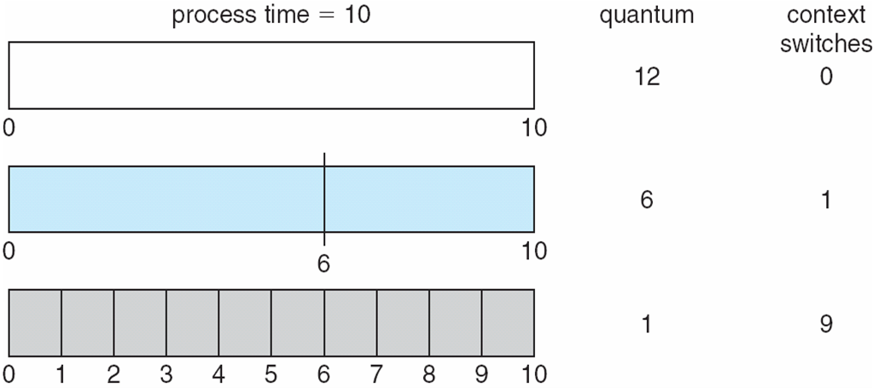
Time Quantum and Context Switch Time

Slide 102
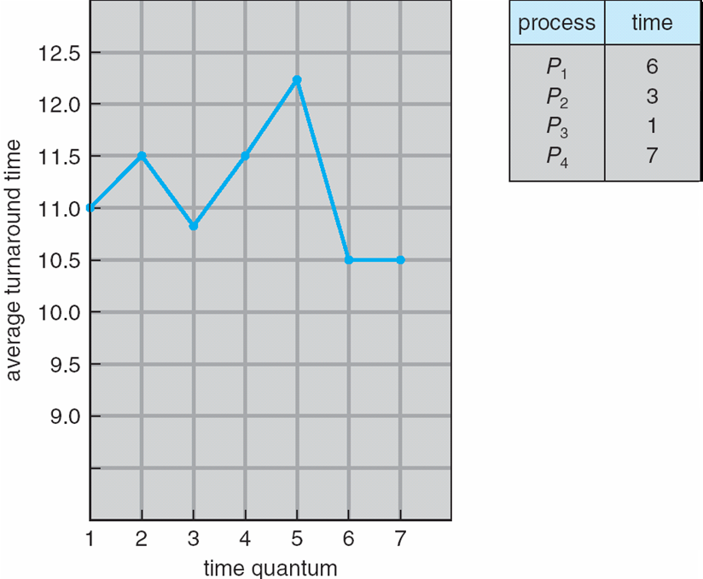
Turnaround Time Varies With The Time Quantum
80% of CPU bursts should be shorter than q

Slide 103
Multilevel Queue
Ready queue is partitioned into separate queues, eg:
foreground (interactive)
background (batch)
Process permanently in a given queue
Each queue has its own scheduling algorithm:
foreground – RR
background – FCFS
Scheduling must be done between the queues:
Fixed priority scheduling; (i.e., serve all from foreground then from background). Possibility of starvation.
Time slice – each queue gets a certain amount of CPU time which it can schedule amongst its processes; i.e., 80% to foreground in RR
20% to background in FCFS

Slide 104
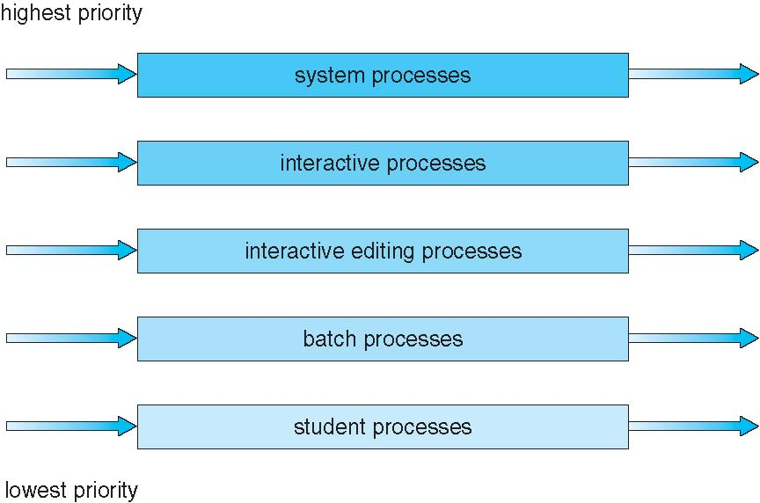
Multilevel Queue Scheduling

Slide 105
Multilevel Feedback Queue
A process can move between the various queues; aging can be implemented this way
Multilevel-feedback-queue scheduler defined by the following parameters:
number of queues
scheduling algorithms for each queue
method used to determine when to upgrade a process
method used to determine when to demote a process
method used to determine which queue a process will enter when that process needs service

Slide 106
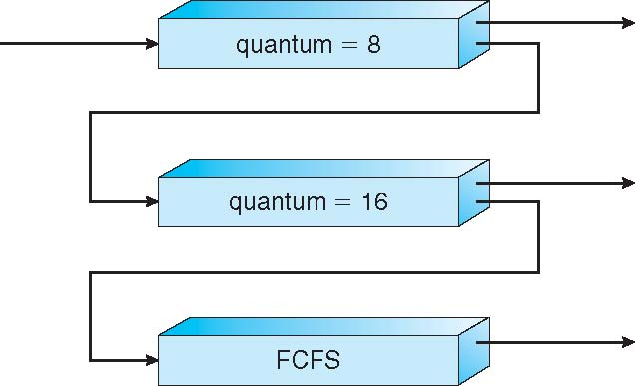
Example of Multilevel Feedback Queue
Three queues:
Q₀ – RR with time quantum 8 milliseconds
Q₁ – RR time quantum 16 milliseconds
Q₂ – FCFS
Scheduling
A new job enters queue Q₀ which is served FCFS
When it gains CPU, job receives 8 milliseconds
If it does not finish in 8 milliseconds, job is moved to queue Q₁
At Q₁ job is again served FCFS and receives 16 additional milliseconds
If it still does not complete, it is preempted and moved to queue Q₂

Slide 107
End of Chapter 6

